Slide 1
CME on Screening and Prevention of Cervical cancer

Slide 2
A CME on Screening and Prevention of Cervical Cancer was organised at Sir Ganga Ram Hospital on 27/3/18, under the aegis of Cervical Cancer Awareness and Prevention Sub-committee of AOGD, ISOPARB, ISCCP, IMS-Delhi Chapter.
About 64 delegates participated in the CME.

Slide 3
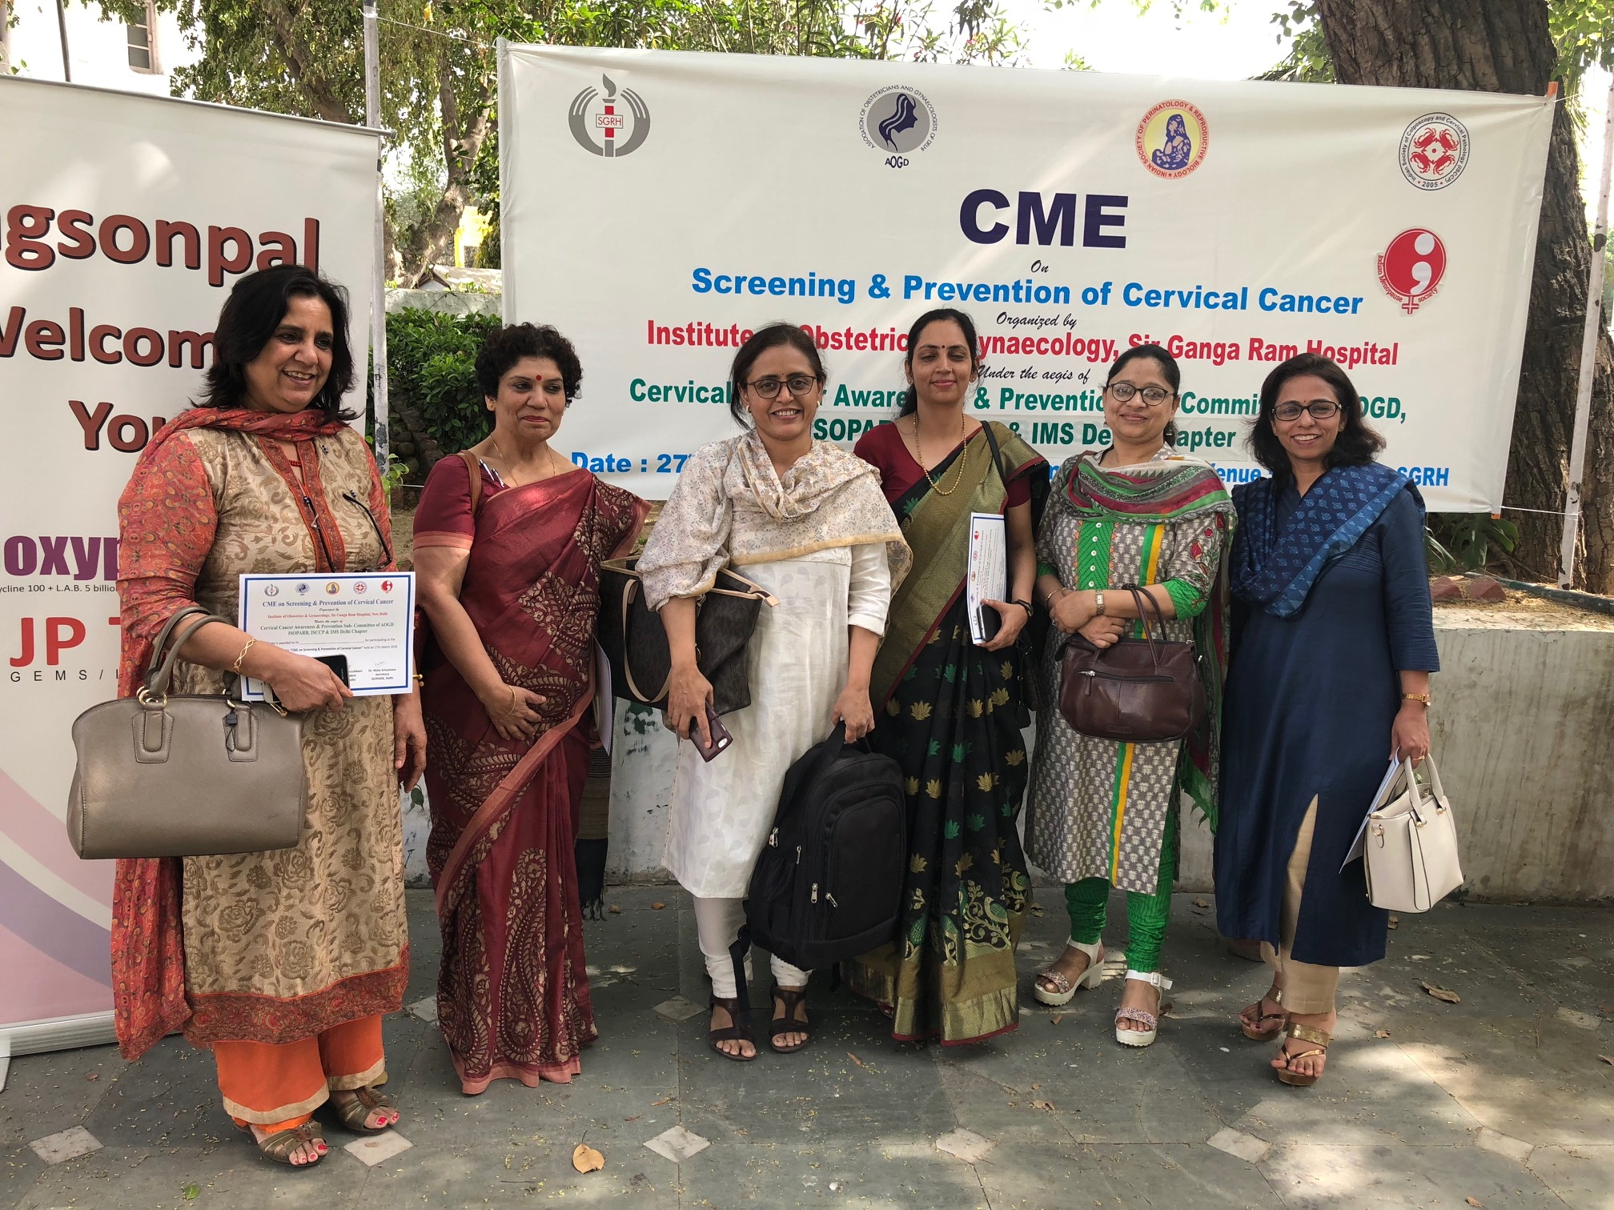

Slide 4
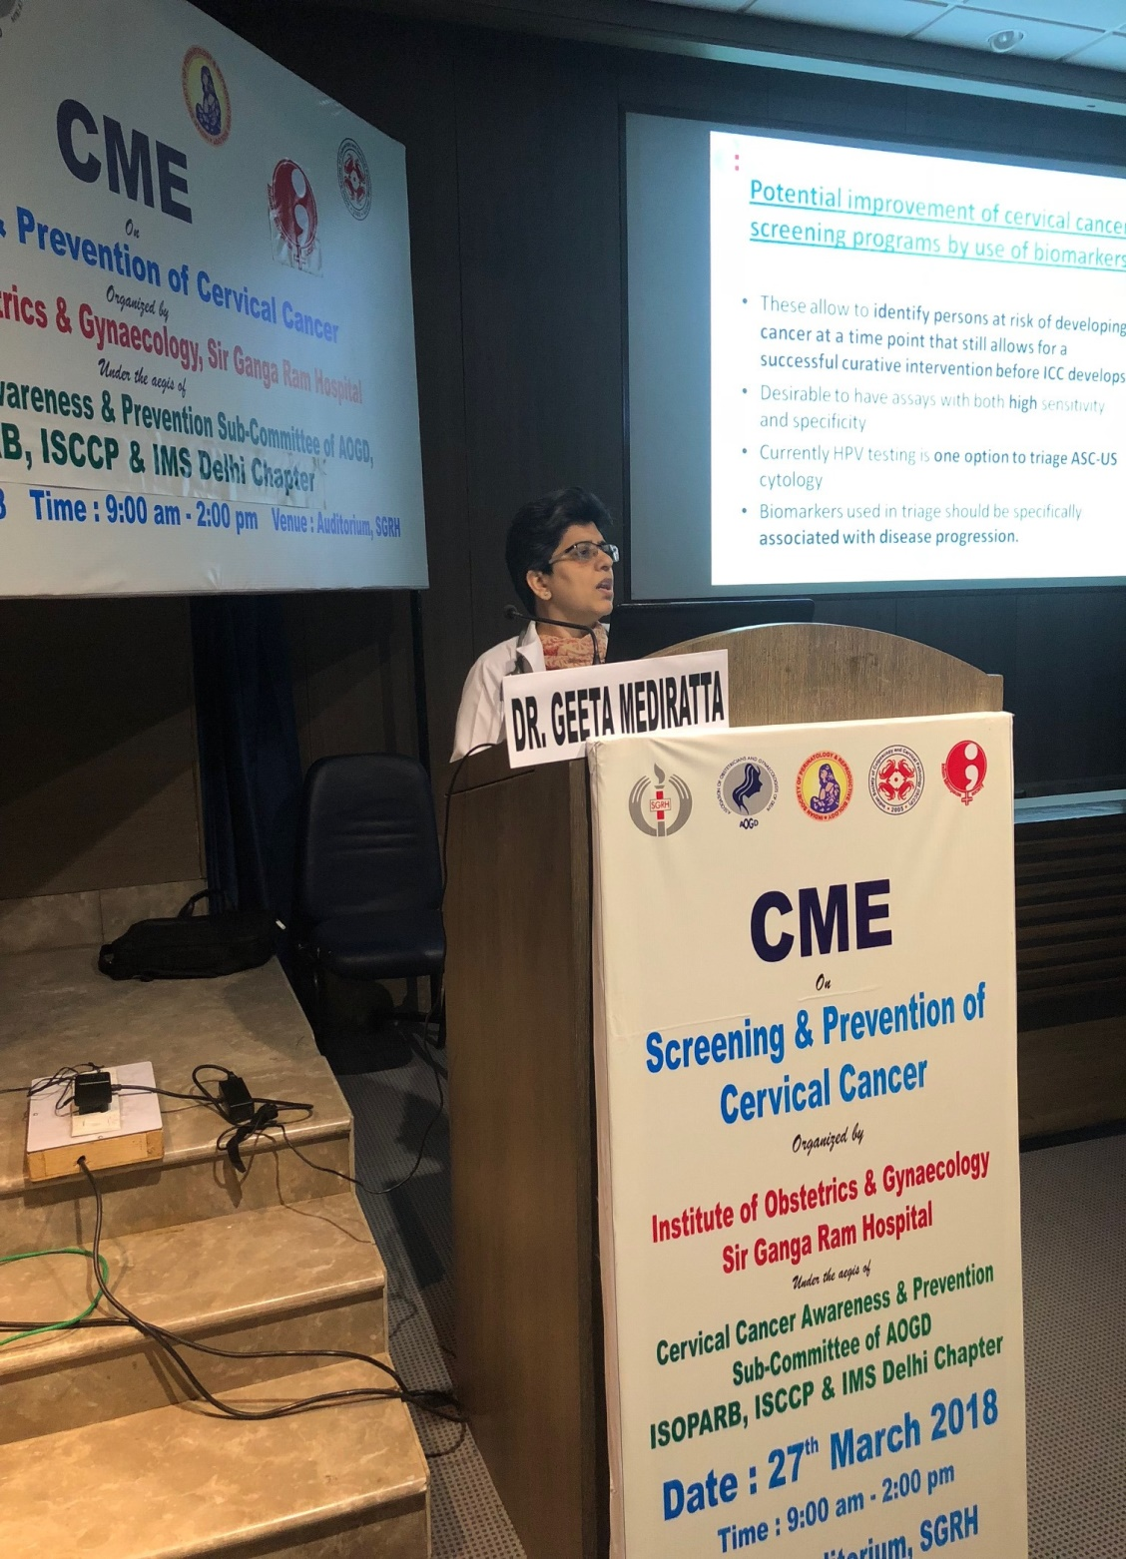
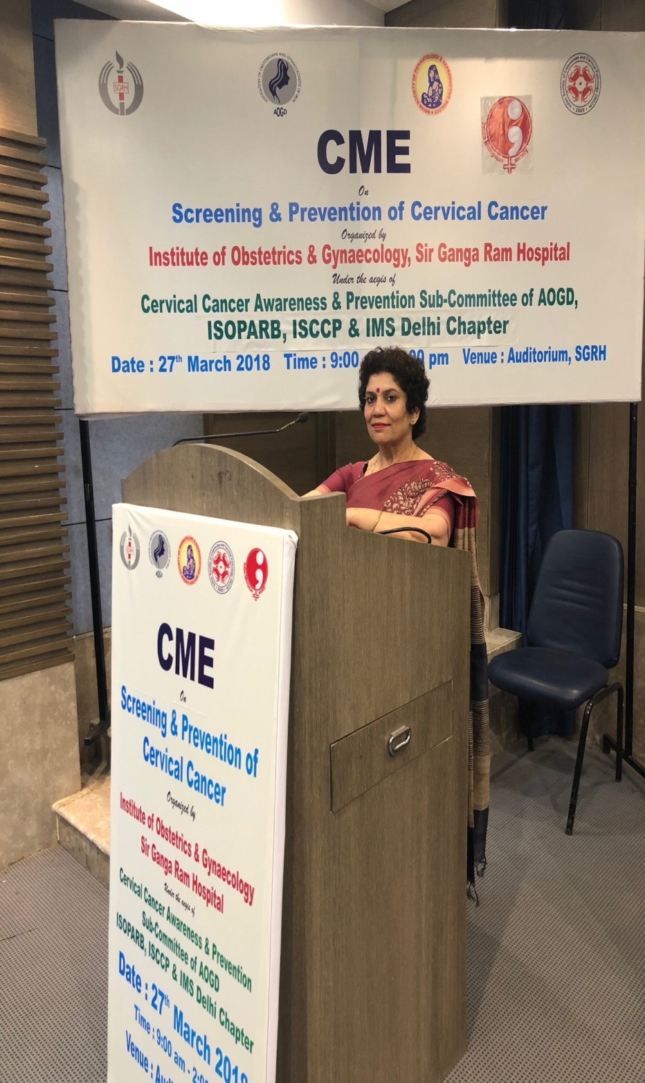

Slide 5
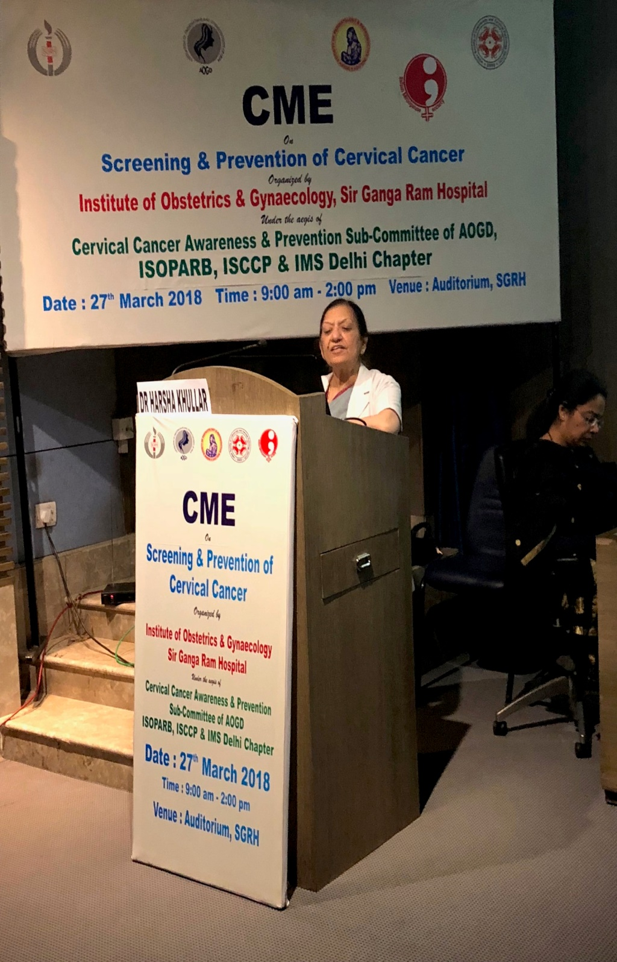
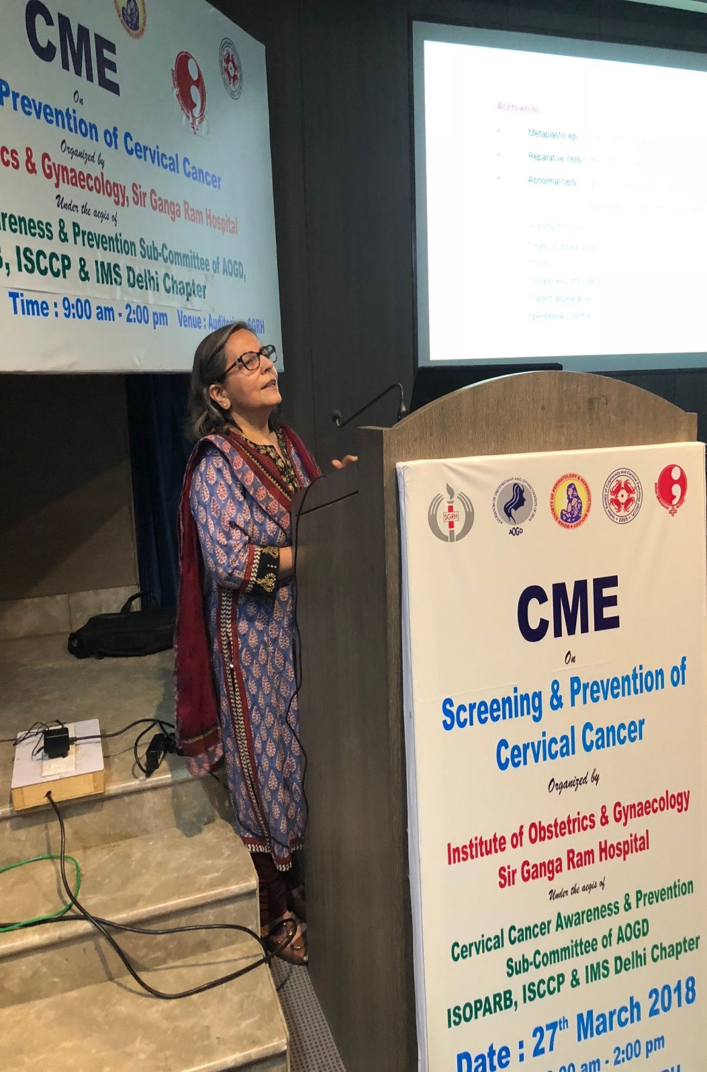

Slide 6
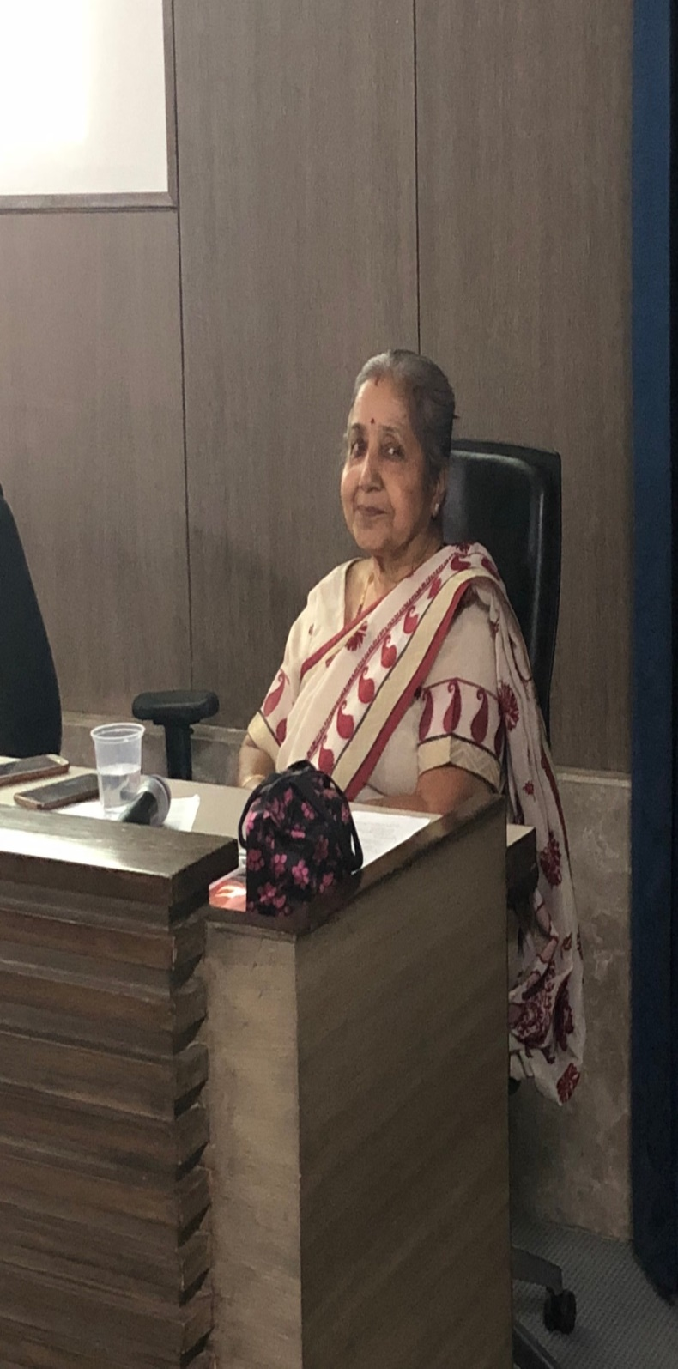
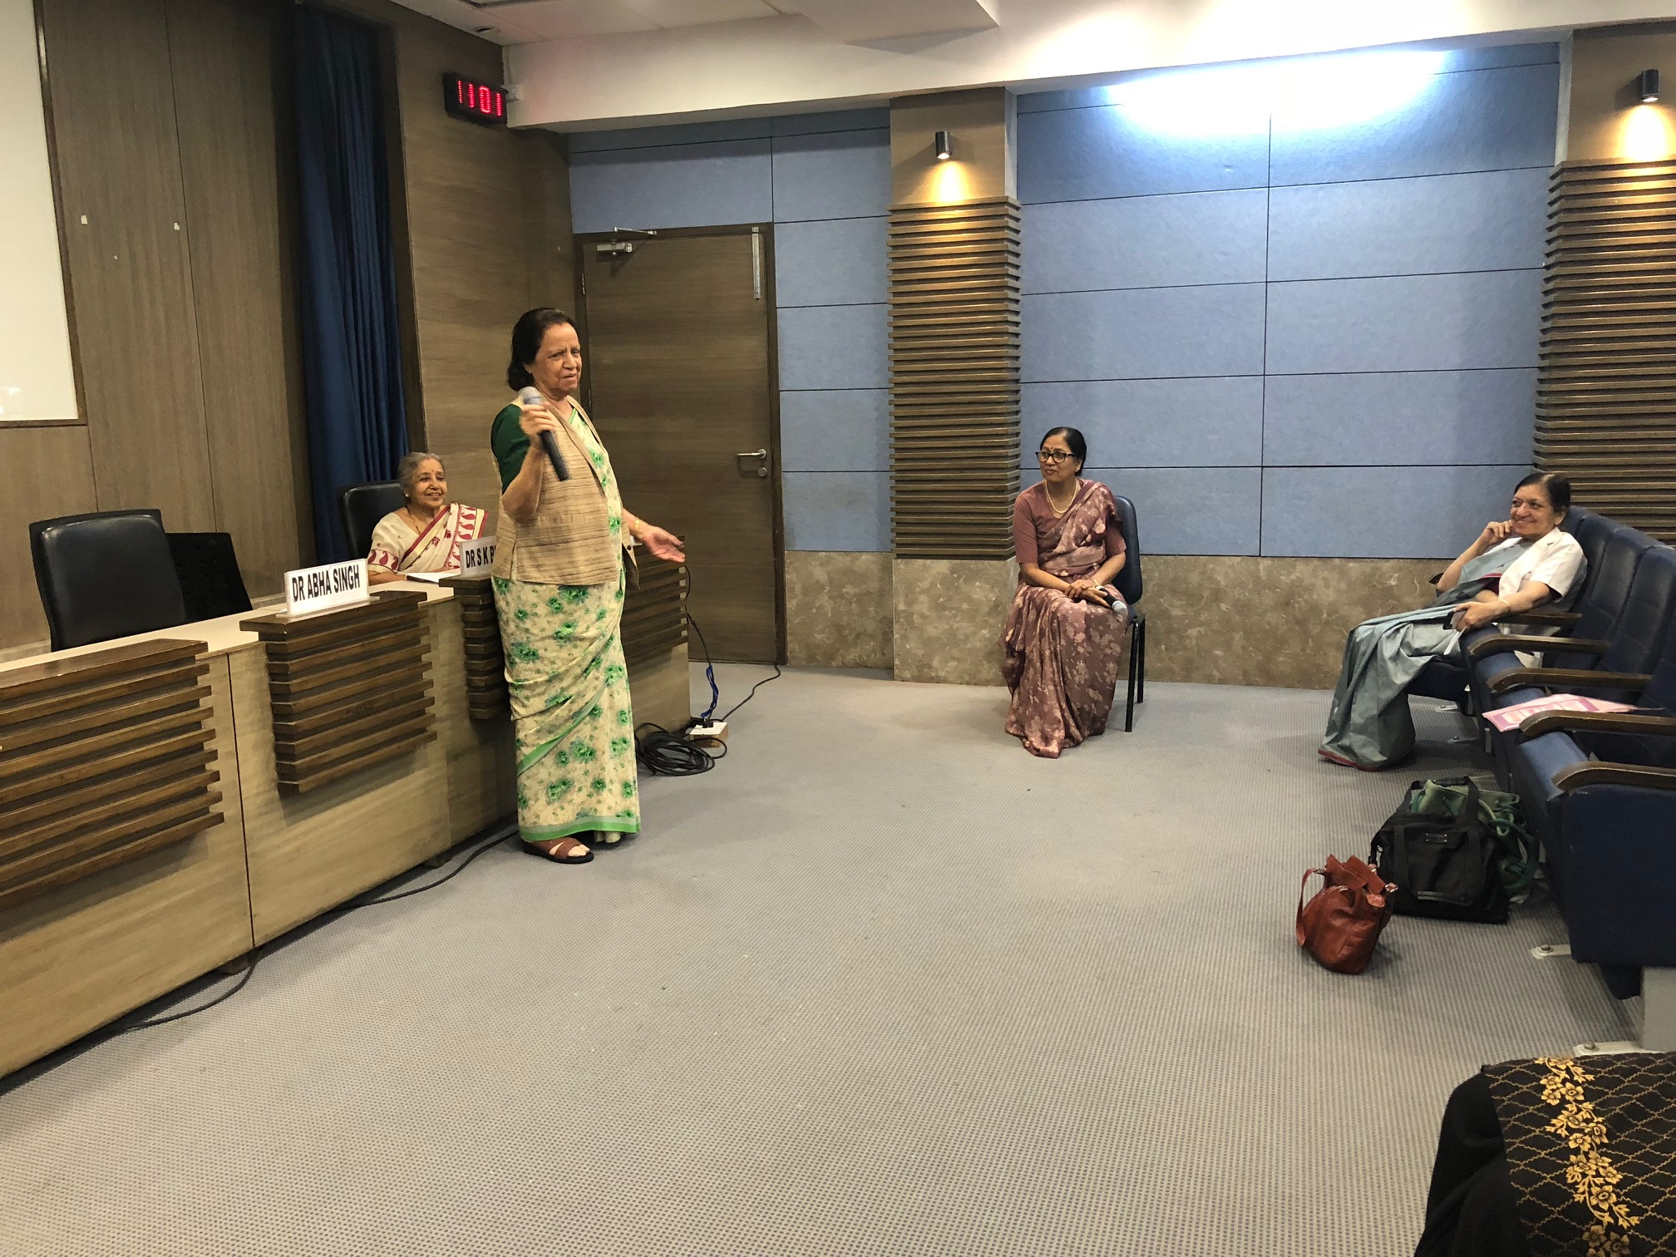

Slide 7
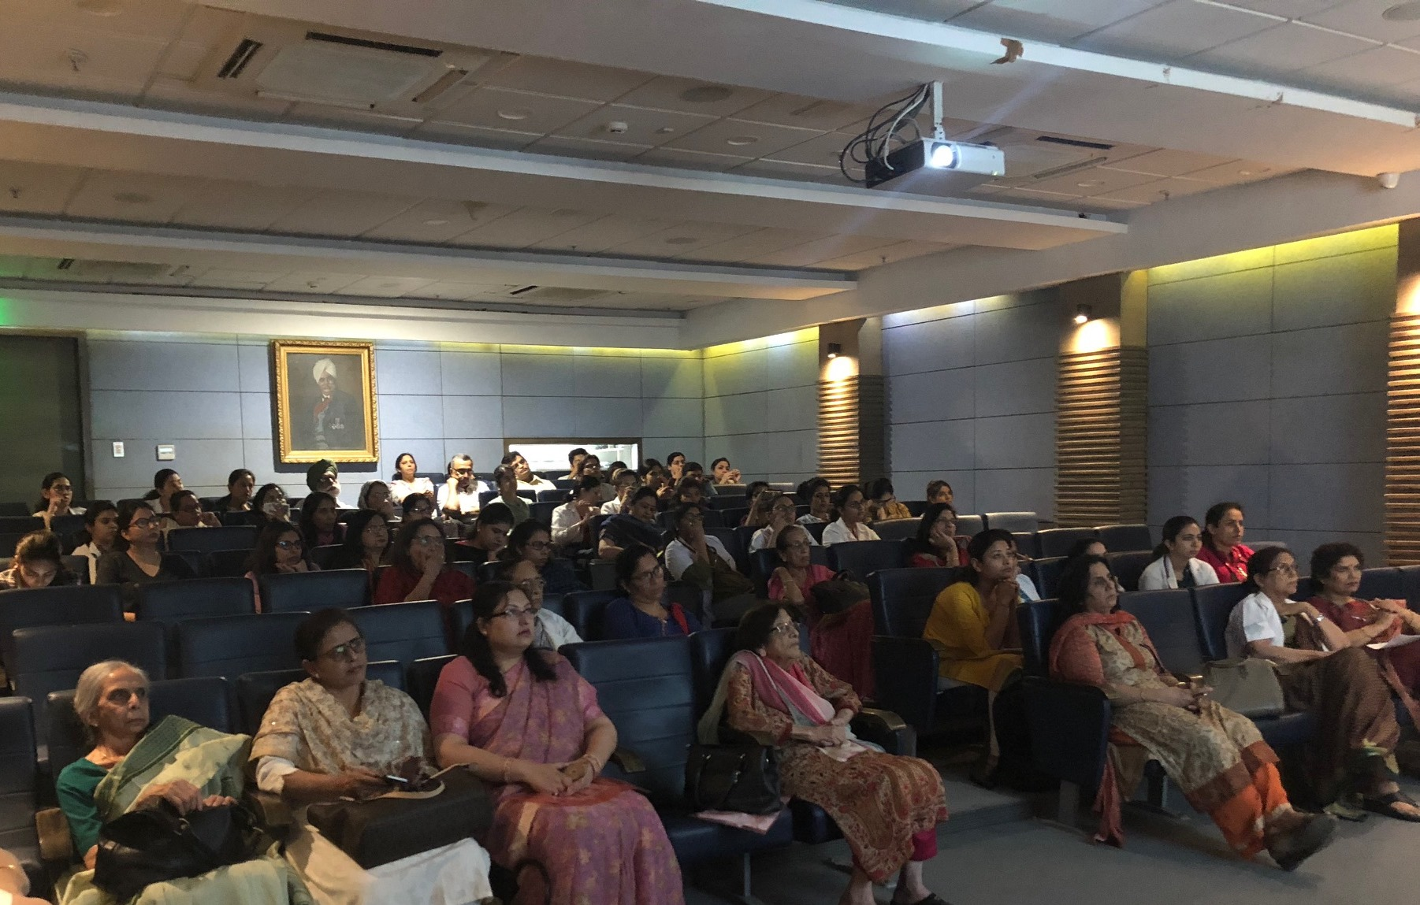

Slide 8
